Slide 1

E/L A02 CAREER INTELLIGENCE
ITECH3208 PROJECT DEVELOPMENT
FINAL PRESENTATION

Slide 2
Roles and structure of group
Team members
Vidhi Modi (30391470) – Project Manager and Scrum Master, Developer
Rajan Patel (30391474) – Process Analyst and Change Manager
Sajal Singh (30376237) – Developer and UX/UI Designers.
Hetkumar Patel (30391427) – Operational Manager and Analyst

Slide 3
Description Of the Project
First phase
- To design and test a fully working interactive course on the open-source Learning Management System
- To create and deploy the Career Intelligence web app, which assists learners in creating interactive CVs.
Second Phase - The development of a Career Intelligence web app that will allow learners to communicate with domain experts about career options
- To create their own interactive career interest profiles, as well as the creation of a knowledgebase structure and prototype.

Slide 4

Clients
1.Marketa Mojzisova, E/L Programme Manager
2.Anirudh Phadke, Head of Digital Content
3.Supriyo Chaudhuri, Chief Learning Officer

Slide 5

Technical aspects of the project
GitHub – Project Management
MS-teams- Team meeting and client meeting
Figma – UX designing Coding
Html
CSS
JAVASCRIPT
XAMPP- MySQL, phpMyAdmin
PHP
Software testing

Slide 6
Sprint 1
Creating wireframes and prototype for the Career Intelligence web app.
Creating Static Homepage of Career Intelligence web-app.

Slide 7
Feedback From Clients in Sprint 1
Feedback from Marketa
-Conduct a more in-depth analysis of similar sites.
-Demonstrates how to add some new concepts to our site to make it more user-friendly.
-Refers us to Anirudh, the project's technical client, for technical inquiries.
Feedback from Anirudh When building wireframes, think about all the options and keep our end user's requirements in mind
- Visit H5P.org and Moddle.org for more ideas

Slide 8
Sprint 2
Creating dynamic website for Home page, Sign-up page, login page of the Career Intelligence cv web app.
Testing the login and signup validation.
Creating static layout and prototype for about page.

Slide 9
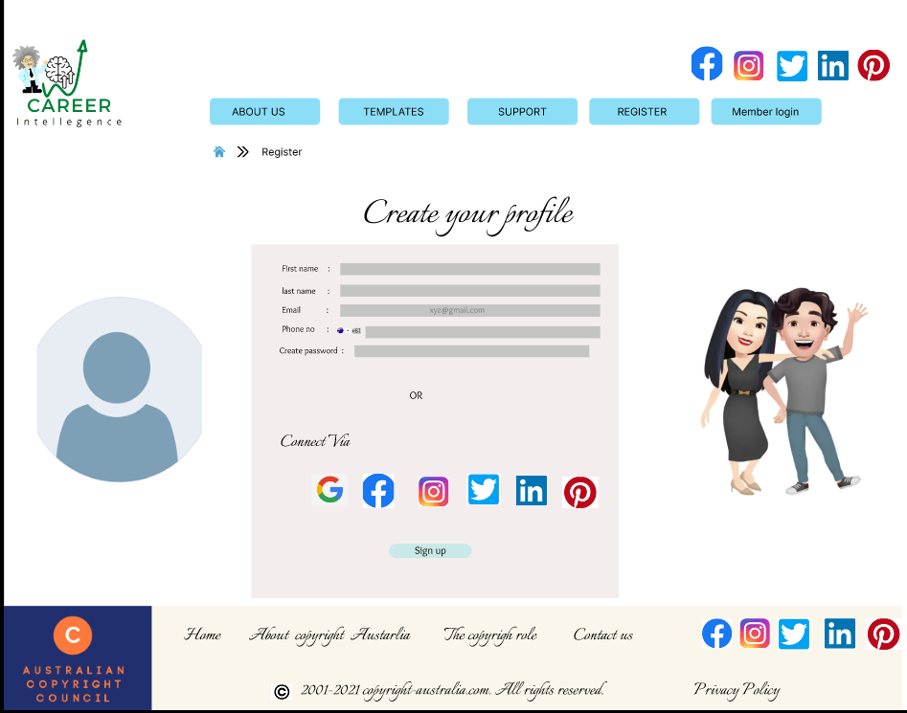
Product backlog 1: High Priority US 1: AS a user I want to register as a new user.
Justification - High Priority
Provide Personalize Information Click on to sign up button and information will be saved to the database.

Slide 10
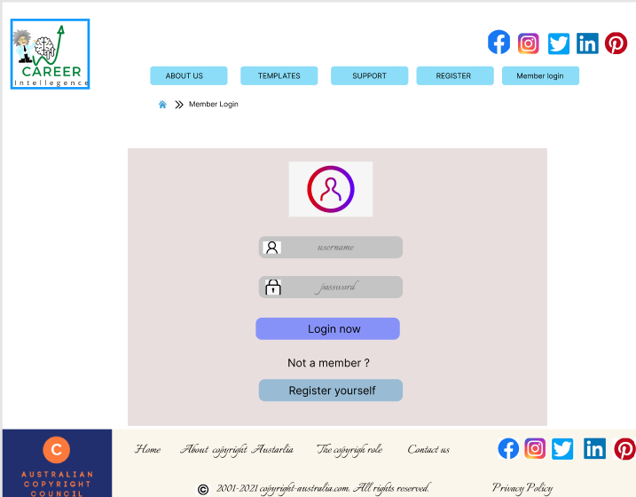
Product Backlog 2 :
After registration user has to login by providing his details that he provided while registering himself in the sign-up page.
Database will check the username and password.

Slide 11
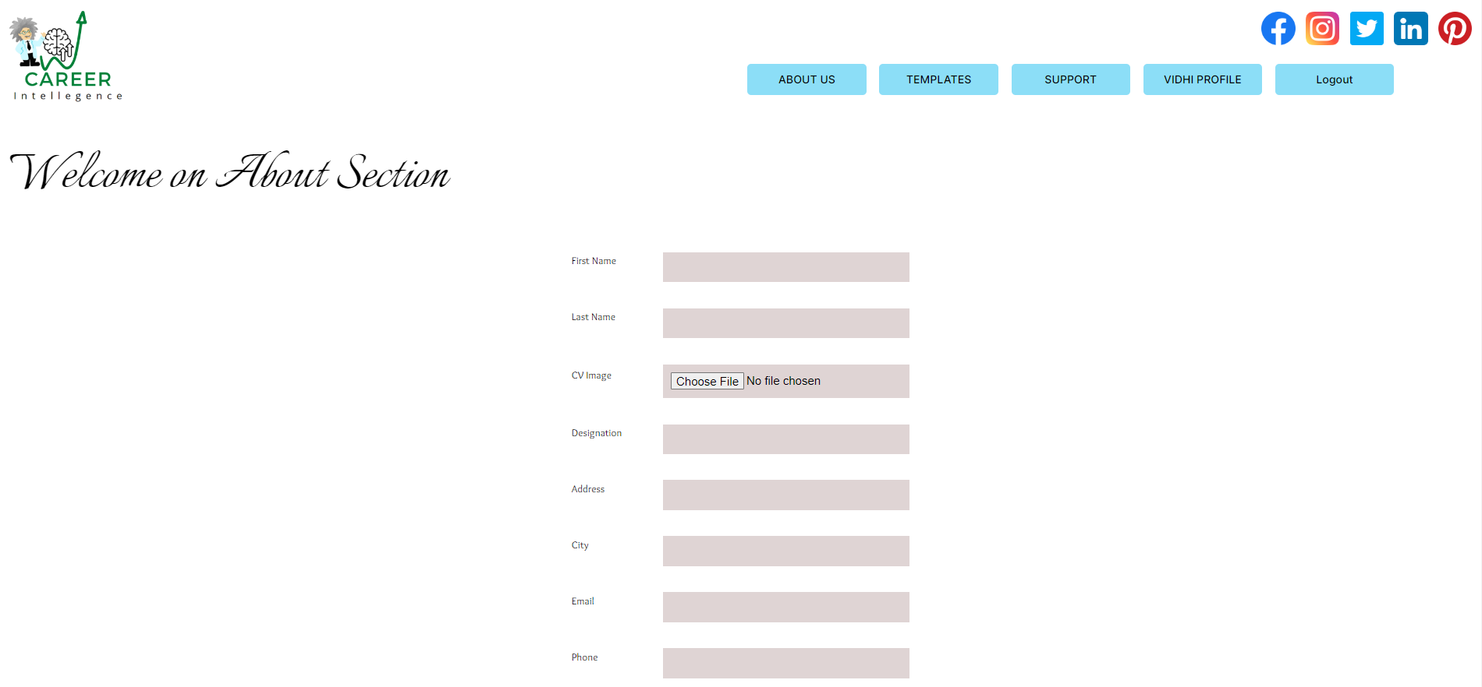
Product Backlog 3 :
High Priority
User must enter his details on the About page before making his CV.
Database stores the information entered by the user.

Slide 12
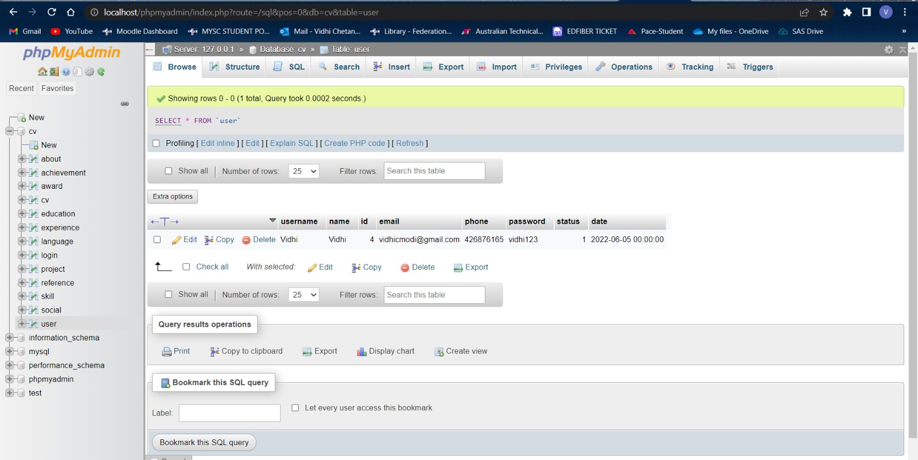
Database of users stored during sign up process

Slide 13
Link to Prototype
Https://www.figma.com/proto/6y7bjLNzaXEJKTSccG8Dxq/Untitled?node-id=2%3A4&scaling=scale-down&page-id=0%3A1&starting-point-node-id=2%3A4

Slide 14
Critical Reflection
What went well?
What went wrong?
All the attendees were on time.
The client was impressed with our ideas and told us that we are on track with our assessment.
Creation of website home page using coding.
The client agreed with our work and provided ideas regarding the upcoming sprint.
We were able to complete our coding and combing work of the project on time
Both sprint works according to our planning.
As we have an average idea regarding coding it creates mixed up for us to develop our website accurately.
We had a few difficulties having meetings on regular basis to decide the progress and some problems occurred with us while consolidating work with each other.
As we were lacking with coding skills, we were only able to create a dynamic website for home page and login page other than that we are still in static phase.

Slide 15
Feedback From Clients in Sprint 2
Feedback from Anirudh - We proposed some premium features through a paid subscription, for which denied and stated that we aren’t looking for paid services and providing open-source.
- Regarding Marketa’s suggestion for AI scanning he suggested not to think of that as of now as it would be too complex for us to do.
- He also suggested not making the web app complicated.
Overall he was happy to see the progress of the project
Feedback from Marketa
-Good progress and on track regarding the scope of the project.
-Suggested to provide AI links for scanning of the project.

Slide 16

Any questions?

Slide 17

Thank You

